Slide 1
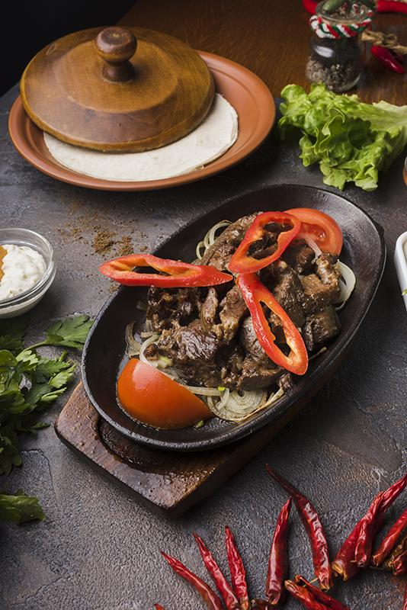
Restaurant Management System
PreHere is where your presentatifgfgfhhfffdhghtdthnggon begins
Presented By: Presented To:
Shuhurat Fariha (22201252) Alif Ruslan
Maisha Sameha (22201266) Lecturer,
Department Of CSE
University Of Asia Pacific

Slide 2

TABLE OF CONTENTS
03
04
Introduction
ER(Entity Relationship) Diagram
Schema Diagram
Entities and Attributes
Entity Relationships
Queries
Importance Of Restaurant management System
Conclusion

Slide 3
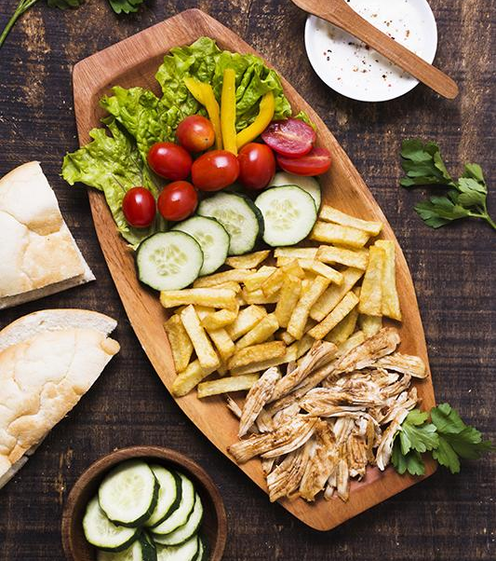
Introduction
Restaurant Management System is a database system that helps manage a restaurant’s operations, including orders, staff, waiter and customer data.
Restaurants faces challenges such as managing orders and customer data, risk of billing errors and food shortages. That’s why we need this system for centralized database management, faster operations and better business growth.

Slide 4
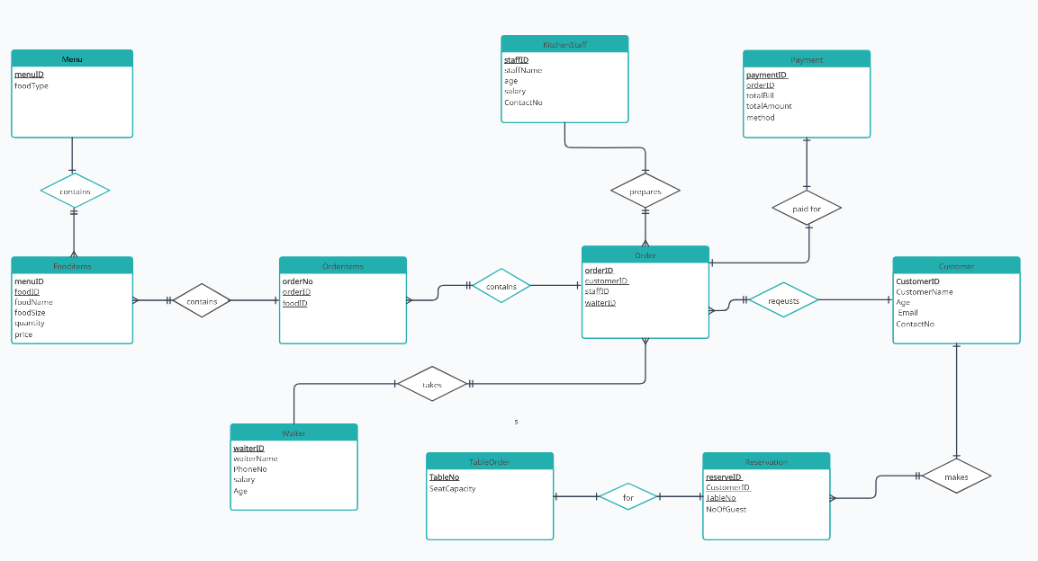
ER(Entity Relationship) Diagram

Slide 5
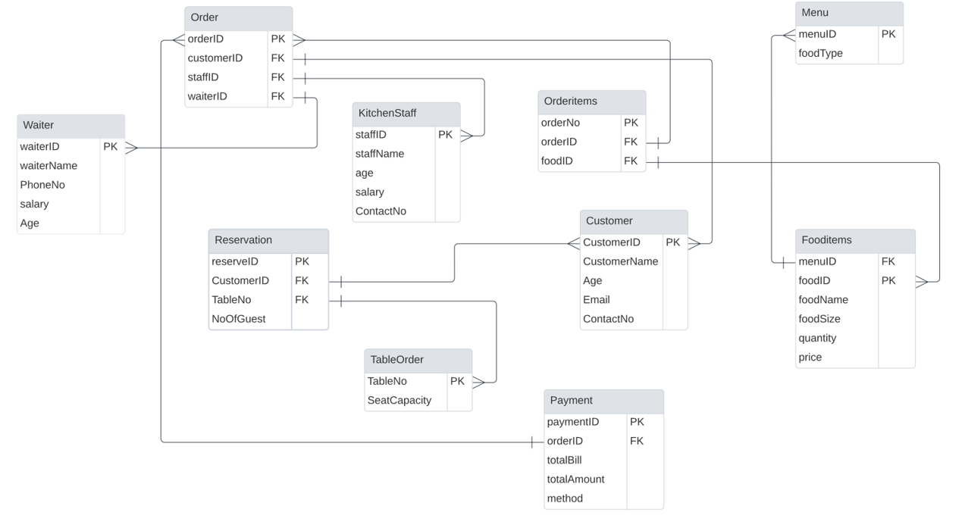
Schema Diagram
Insert your logo

Slide 6
Entities And Attributes
Waiter
Attributes: WaiterId, WaiterName, PhoneNo, Salary, Age
Purpose: This table is created to manage information and personal details about the restaurant's waiters who serves a particular order.
KitchenStaff
Attributes: StaffId, StaffName, Age, Salary, ContactNo
Purpose: This table is created to manage the personal details of kitchen staff responsible for preparing food according to the order.
Customer
Attributes: CustomerId, CustomerName, Age, Email, ContactNo
Purpose: The table is created to store information about customers who requests order.

Slide 7
Entities And Attributes
TableOrder
Attributes: TableNo, SeatCapacity
Purpose: This table is created to manage table information in the restaurant which helps manage seating arrangements.
Reservation
Attributes: reserveId, Customer_id, TableNo, NoOfGuests Purpose: This table is created to manage reservations made by customers.
Menu
Attributes: menuId, foodType
Purpose: This table is created to classify food into categories such as salads, main courses, desserts, etc.

Slide 8
Entities And Attributes
FoodItems
Attributes: menuId, foodId, foodName, foodSize, quantity, price
Purpose: This table is created to list all the food items available in the restaurant.
OrderTable
Attributes: orderId, StaffId, CustomerId, WaiterId
Purpose: This table is created to manage customer orders. This is a Central table linking customers, waiters, and kitchen staff.
OrderItems
Attributes: orderNo, orderId, foodId
Purpose: This table is created to detail the food items in each order.
Payment
Attributes: paymentId, orderId, totalBill, totalAmount, method
Purpose: This table is created to manage payment details for orders.

Slide 9
Entity Relationship
Order <-> Payment
Relationship: An order is paid for by a payment. [1:1]
Reservation<->TableOrder
Relationship: A reservation is for a specific table.[1:1]
Menu<->FoodItems
Relationship: A menu contains multiple food items.[1:M]
Customer<->Reservation
Relationship: A customer makes many reservation.[1:M]
Order<->OrderItems
Relationship: An order contains multiple order items. [1:M]

Slide 10
Entity Relationship
Waiter <-> Order
Relationship: A waiter takes multiple orders. [1:M]
OrderItems<->FoodItems
Relationship: Many order items contain one Food item.[M:1]
Order<->Customer
Relationship: A customer requests many orders.[M:1]
Customer<->Reservation
Relationship: A customer makes a reservation.[1:M]
Order<->KitchenStaff
Relationship: Kitchen staff prepares orders.[1:M]

Slide 11
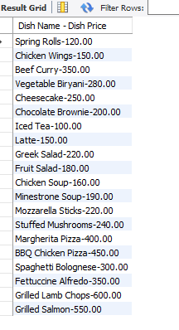
Queries
Dish names with its’ prices:
select concat (foodName ,'-' ,price) as "Dish Name - Dish Price" from Fooditems ;
Insert your logo

Slide 12
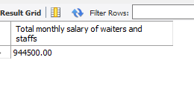
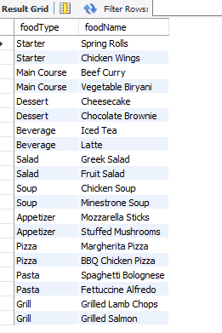
Queries
Monthly salary of all waiters and kitchen staff:
select(select sum(salary ) from Waiter )+ (select sum(salary ) from KitchenStaff) "Total monthly salary of waiters and staffs";
Food types and their corresponding dishes:
SELECT Menu.foodType,FoodItems.foodName FROM FoodItems JOIN Menu ON FoodItems.menuID = Menu.menuID;
Insert your logo

Slide 13
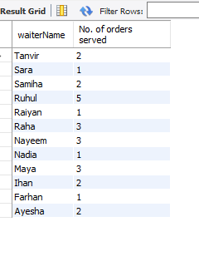
Queries
Amount of orders served by each waiter:
SELECT Waiter.waiterName, SUM(Payment.totalAmount) "No. of orders served" FROM Waiter JOIN Order_ ON Waiter.waiterID = Order_.waiterID JOIN Payment ON Order_.orderID = Payment.orderID GROUP BY Waiter.waiterName ORDER BY waiterName DESC;
Insert your logo

Slide 14
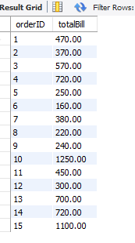
Queries
Bill of each OrdersIDs:
SELECT orderID, SUM(f.price) AS totalBill FROM OrderItems JOIN FoodItems f ON OrderItems.foodID = f.foodID GROUP BY orderID ORDER BY orderID;
Insert your logo

Slide 15
Importance Of Restaurant Management System
Centralized Data Management:
All entities, such as Customers, Orders, Menu, and Staff, are interconnected, as shown in the ER and Schema diagrams. Also Helps manage customer, order, and payment information easily.
Efficient And Accurate Service:
It helps staff work faster and more accurately with orders, payments, and customer details.
Enhanced Customer Experience:
Allows quick access to reservation, order, and menu data, improving service speed and dining experience.

Slide 16
Importance Of Restaurant Management System
Accurate billing and payments:
Ensures accurate calculations for orders and payments.
Streamlined Operations:
Coordinates between waiters, kitchen staff, and customers for smooth operations.

Slide 17
Conclusion
In conclusion, the Restaurant Management System simplifies operations by organizing important information, enabling faster and more accurate service, and ensuring effective inventory management. These features not only reduce errors and save time but also enhance customer service, keeping the restaurant running smoothly. This system is a vital tool for modern restaurant management, ensuring efficiency and customer satisfaction.

Slide 18
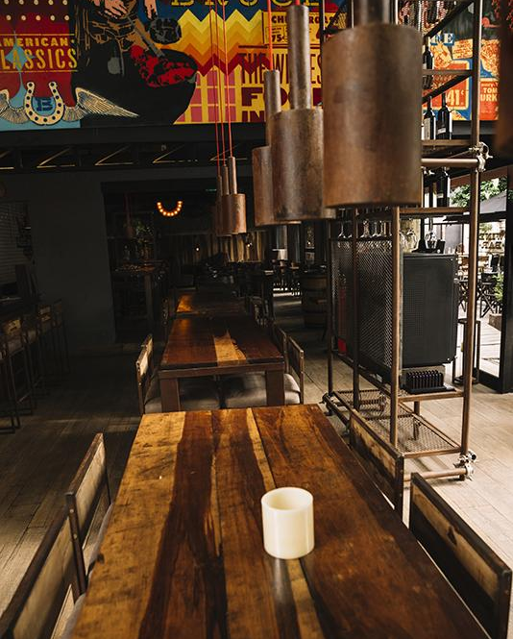
THANKS!
Do you have any questions?
22201252@uap-bd.edu
22201266@uap-bd.edu
Credits: This Presentation was created by Shuhurat fariha and Maisha Sameha
Insert your logo

